Slide 1
Dynamo Primer
Paolo Emilio Serra
Implementation Consultant | @PaoloESerra; puntorevit.blogspot.com

Slide 2
Goals
What is Dynamo and how it works
How to create and use Dynamo and maintain graphs
Revit API overview and Dynamo integration
Open discussion on automation applications

Slide 3
Agenda
Dynamo Overview
User Interface
Graphs Management
Autodesk Standards
Visual Programming Principles
Filtering, Grouping & Sorting
Dynamo-Excel Link
Design Script
Geometry Library
Automation Applications
Dynamo for Revit
Dynamo & Python
Object Oriented Programming
Revit API Introduction
Next Steps

Slide 4
Dynamo Overview

Slide 5

What is Dynamo?
Open-source software platform
Visual interface to construct logic routines
Geometry creation
Workflow automation
Interface for multiple software

Slide 6
Automation Business Values
Reducing man hours
Ensure Data completeness
Enable Interoperability between different platforms
Improve the efficiency of existing workflows and create new ones
Improve the collaboration
Enhance technology adoption

Slide 7

Learning Resources
DynamoBIM.org
DynamoPrimer.com
DynamoNodes.com
GitHub/DynamoDS
http://dynamods.github.io/DynamoAPI/
Blogs, YouTube videos
AU lessons and handouts
http://www.revitapidocs.com/code/
Lynda.com / CadLearning.com

Slide 8
Dynamo Timeline
Ian Keough nights and weekends 2011
Labs - Revit and Vasari 2013
Default with Revit 2015 R2
Dynamo Studio 2015
Cad Learning/ Lynda - Dynamo
Primer 2015
Autodesk University 2015
Version 1.3 Dynamo Player
Robert Aish Design Script 2012
Version 2.1 JSON format

Slide 9
User Interface

Slide 10
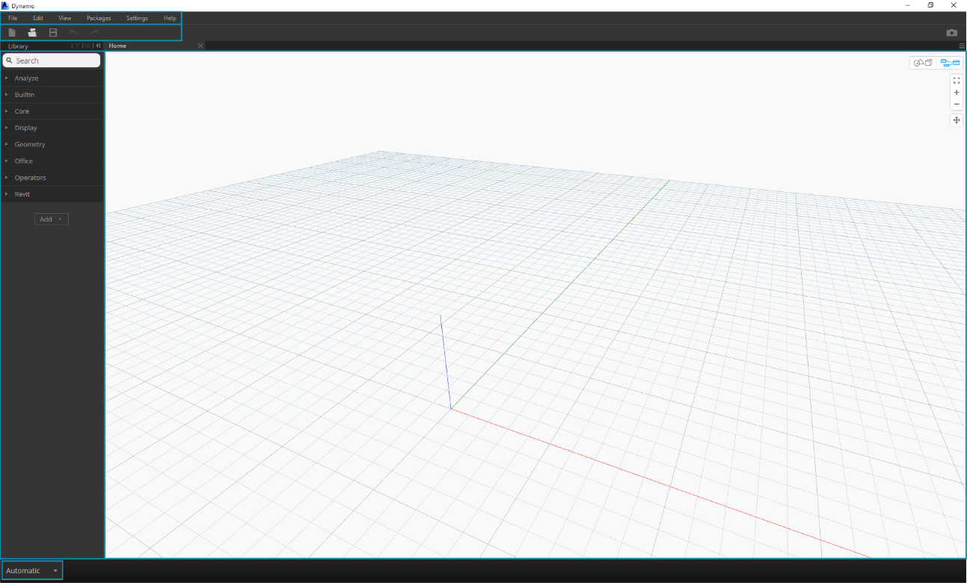
Visual Programming
Menus
Toolbar
Library
Execution Bar
Work space

Slide 11
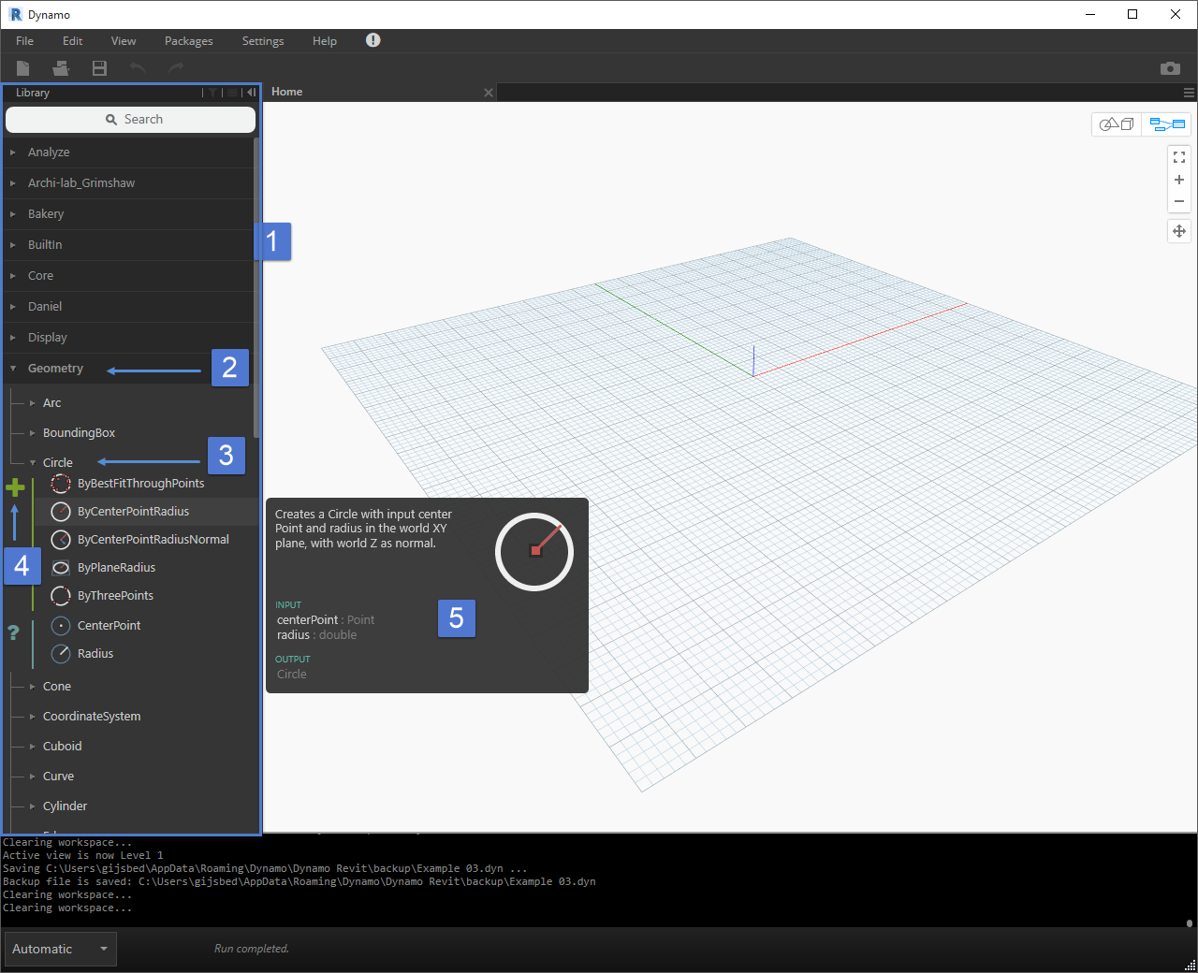
Visual Programming
Notes:
The Library - The region of the Dynamo Interface
A Shelf - A collection of related Categories, such as Geometry
A Category - A collection of related Nodes such as everything related to Circles
A Subcategory - Breakdown of the Nodes within the Category, typically by Create, Action, or Query
A Node - The objects that are added to the Workspace to perform an action

Slide 12
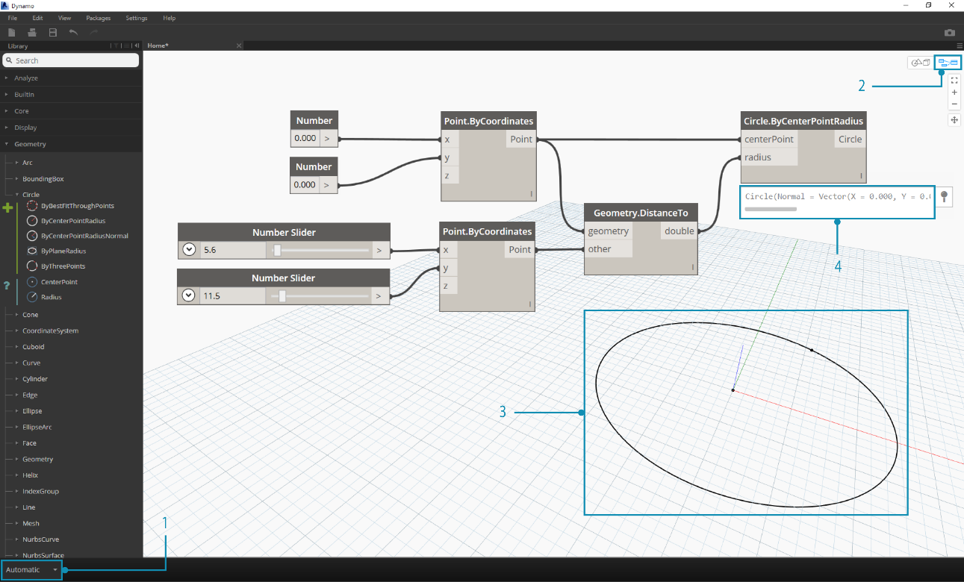
Visual Programming
Notes:
Nodes can be placed in the workspace dragging and dropping from the library, there is a search bar at the top that helps filtering the nodes by name.
There is also a context menu accessible via right click.
Dynamo is unitless: it reads the units of the Revit UIDocument, therefore it is linked to one Revit Document at a time.
Each graph can run in three different mode: Manually (sort of “fire and forget”), Automatic (sort of dynamic model update that triggers as soon as a change is made to the graph or to the inputs), Periodically (it runs at time intervals).
Most of the nodes come with a default input value, hovering the mouse on an input port will show a balloon reporting remarks for the kind of input (kind of data and what format).
Nodes can be fed with one object or a list of objects and their behavior changes based on the lacing settings (Shortest, Longest, Cross Product).
At the bottom of the node there is a debugging feature that shows the result of the execution.

Slide 13
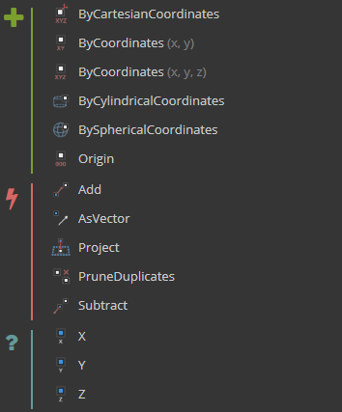

Nodes
Each node is a function with Input and Output ports that take and create lists
3 behaviors:
Create (Constructor)
Action (Method)
Query (Property)
Scripting integration
Design Script (Code block, .ds)
Python
…

Slide 14
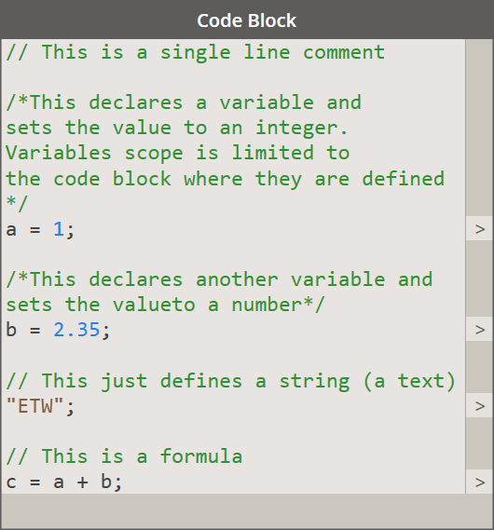
Code Blocks | Generic Purpose Nodes
Double click on the canvas to create
Name = Value;
Case sensitive
End with a semi-colon “;”

Slide 15
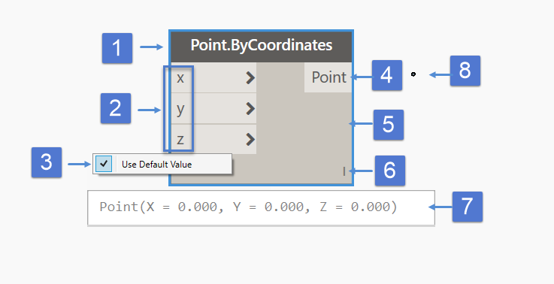
Anatomy of a Node
Notes:
Most Nodes in Dynamo are composed of these parts. While there are exceptions, such as Input Nodes, the anatomy of each Node can be described as follows:
Name - The Name of the Node with a Category.Name naming convention2. Ports (In and Out) - The receptors for Wires that supply the input data to the Node as well as the results of the Node's action
Ports (In) - The receptors for Wires that supply the input data to the Node as well as the results of the Node's action
Default Value - Right-click on an input Port - some Nodes have default values that can be used or not used.
Ports (Out) - The connector for Wires that supply the output data as the results of the Node's action
Main - The main body of the Node - Right-clicking here presents options at the level of the whole Node
Lacing Icon - Indicates the Lacing option specified for matching list inputs (more on that later)
Results
Element in Dynamo canvas of what has been created

Slide 16
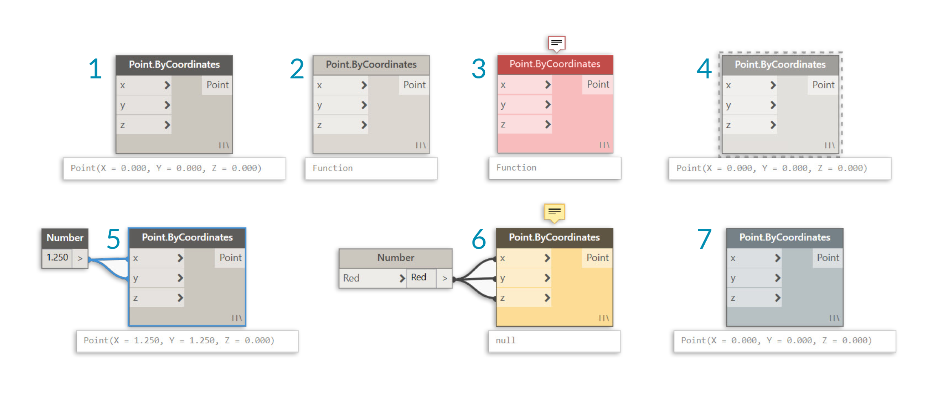
Node States
Notes:
Active - Nodes with a Dark Grey Name background are well-connected and have all of their inputs successfully connected
Inactive - Grey Nodes are inactive and need to be connected with Wires to be part of the Program Flow in the active Workspace
Error State - Red indicates that the Node is in an Error State
Freeze - A Transparent node has Freeze turned on, suspending the execution of the node
Selected - Currently selected Nodes have and Aqua highlight on their border
Warning - Yellow Nodes are in an Warning state, meaning they may have incorrect data types
Background Preview - Dark Grey indicates that the geometry preview is turned off

Slide 17
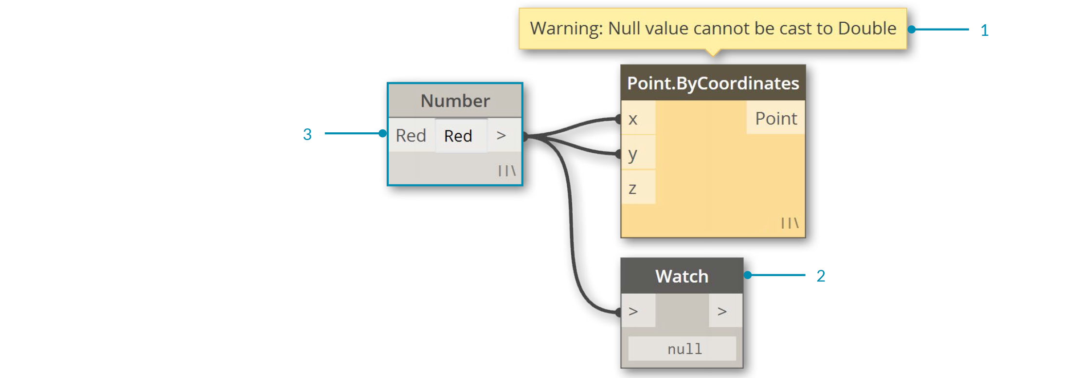
Warnings

Slide 18
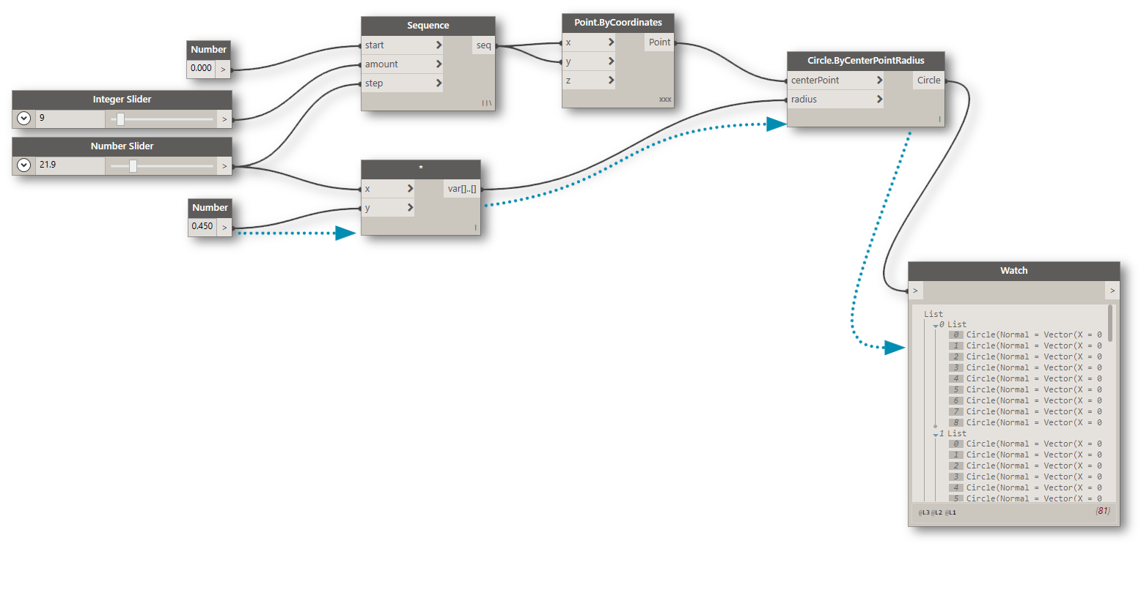
Connectors
They define the routine flow of execution
Always link an output port to an input port
An output port can feed multiple input ports
Selecting a node selects input and output connectors

Slide 19
Graphs Management

Slide 20

Graph Management
Node Alignment
Notes (Commenting)
Grouping
Color coding
Input
Function
Get
Set
Output
Debugging
Notes:
In a visual programming environment it’s really easy to get lost, so there are tools to automatically clean-up the graph and keep it readable for other users.
Align, distribute and minimize the intersection of connectors are feature that can save an impressive amount of time when dealing with a Dynamo graph.
Inserting comments in the graph is always the best solution to leave instructions and explanations, they come in the form of floating nodes and can be grouped with other nodes based on their joined purpose.
In this respect introducing a color coding is another best practice to put in place as a standard to differentiate at least the most common functions of portions of code (Input data, Data Operation, Output and debagging).
The ultimate goal is to make the graph easier to understand and maintain.
Unfortunately there is no function to search and find a specific node in a graph but it is possible to select an object in the 3D background and focus on the node that has the selected entity as output.

Slide 21
Dynamo Graph Files
DYN extension
XML (up to 1.3.3) / JSON (since 2.0) structure
Everyone can access the source code with a text editor
There is still no way to compile and protect a Dynamo graph
Future versions may be not backward compatible
Notes:
The backward compatibility is already gone with version 0.9.1

Slide 22
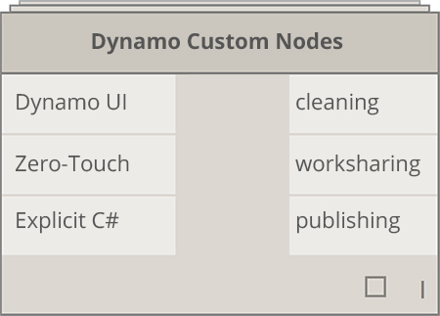
Custom Nodes
Different types:
Create from UI (DYF extension)
Zero Touch Essentials (C#, Standard Node Interface)
Design Script (.ds)
C# (Custom Interface)
Benefits
Clean up definitions
Work sharing
Recursion
Quick adjustments
Expand the capabilities
Notes:
https://github.com/DynamoDS/Dynamo/wiki/How-To-Create-Your-Own-Nodes
Create nodes from the UI -> it creates a node that can be edited in the current Dynamo session but in a dedicated workspace (something like the relationship between Revit Project and the Family Editor)
Zero Touch Essentials, loading a DLL file will create a new shelf in the library named after the namespace used, the structures of the nodes is really simple and it’s based on static methods, the inputs are specified as arguments in the method, it is possible to have single or multi output ports.
Dynamo is written in C# and to implement custom UI there is need to implement a proper NodeModel object using Windows Presentation Foundation (WPF)

Slide 23
Custom Nodes from UI
The custom node is created locally on the machine
Definition is not embedded in the graph
Must distribute with the graph
Easy to do, no coding experience required
Make the graph more robust and easier to read
Nodes can be grouped in custom shelves in the library

Slide 24
Package Manager
Everyone can create a set of nodes and publish it
There is a server that can be searched from within Dynamo or in alternative a website
The packages are self-installing
These are an important part of the quick success
The packages are available for free and so there is no official support or maintenance for them

Slide 25
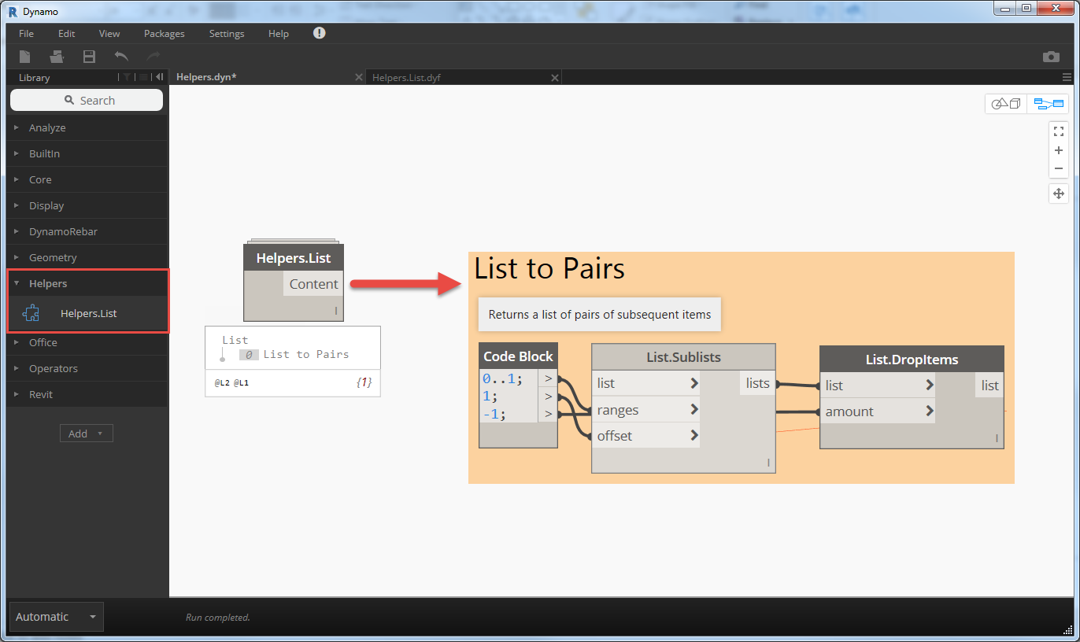
Custom Node Helpers
Recall frequently used node structures
Organize the nodes by custom criteria
Copy from the Custom Node and Paste in the main graph
Easier to maintain and search

Slide 26
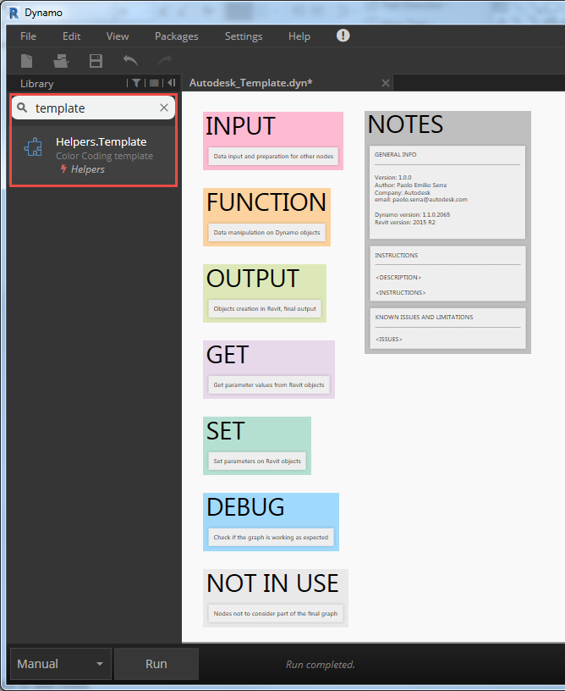
Custom Node Helpers
Enable searches in the Library
Enforce Standards
Reduce time to compose graphs
Easier to maintain and update

Slide 27
Node to Code
A feature that converts UI nodes into a single Code Block using Design Script
Great way to learn Design Script syntax
Clean up the graph
Closer to standard coding
New users tend to stay away from Scripts
There is no “Code to Node” yet
Performance wise there are no differences

Slide 28
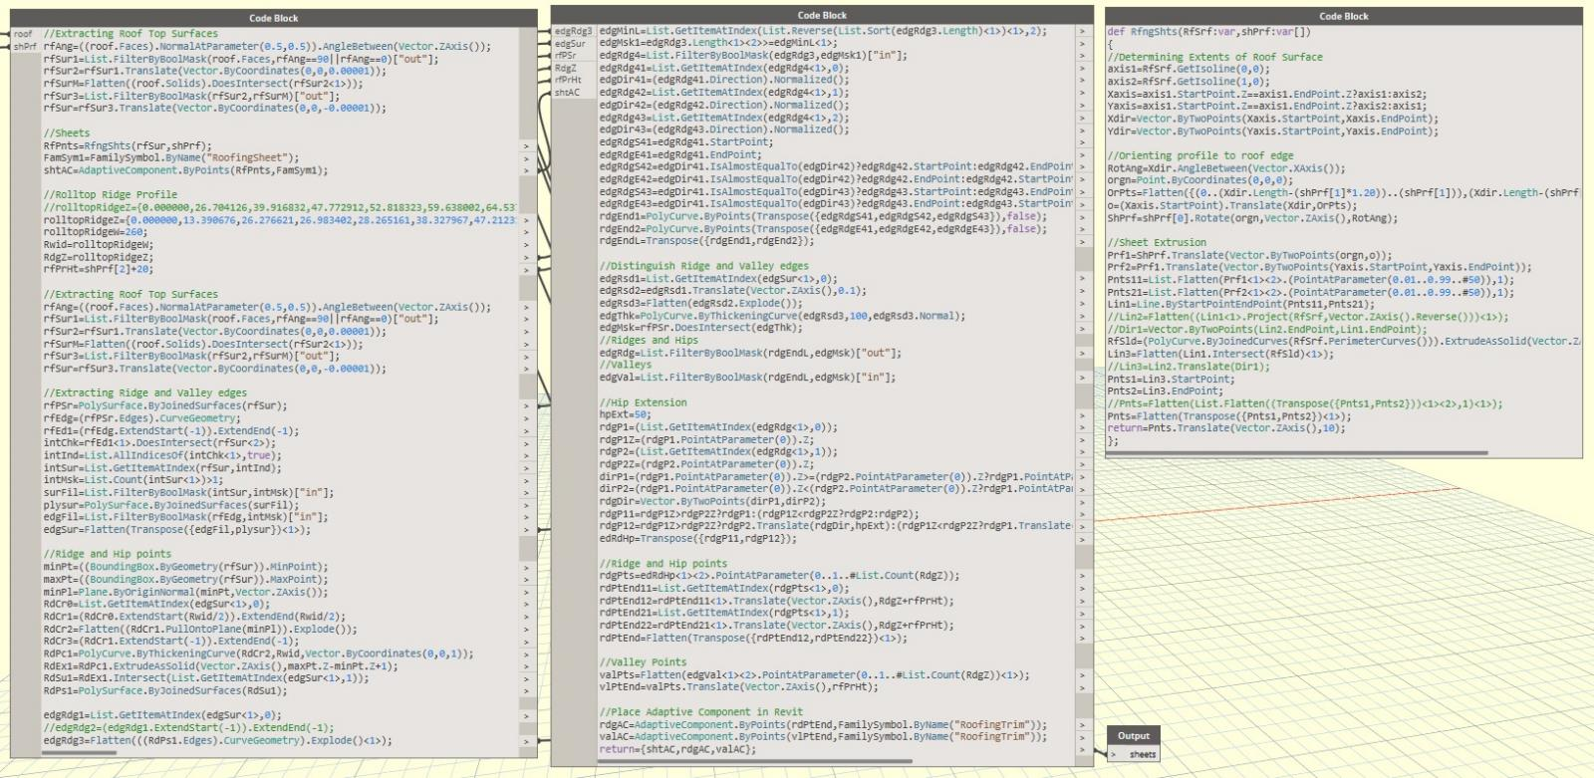
Dynamo Script Example
Notes:
It’s a language developed specifically for geometry tasks and for designers, it’s similar to Java or C# in the syntax (use of curly brackets, end the command with a “;”, comments with “//”).
Each line with code does something and so at the end of the row on the right side of the node will appear an output port so that is would be possible use the return object as input in other nodes.
It is possible to create Dynamo objects and recall all the Create, Action and Query on that object using the do notation.
It is possible to define functions and recall them in other code blocks in the graph using the “def” keyword and specifying only one return value (it might be necessary to return a list of objects).

Slide 29
Dynamo Script
Associative / Imperative language blocks
Replication guides (extends the lacing concept)
Conditional statements
Loops (while / for)
Creation of geometry entities (nurbs curves, nurbs surfaces, loft, revolves, etc.)
Manipulation of geometry entities (Boolean operations, intersection, trims)
Creation of Custom Nodes
Notes:
Dynamo code can be Associative or Imperative: in associative Dynamo code, if a collection of elements is used as the input to a function which normally takes a single value, the function is called individually for each member of a collection. In imperative Dynamo code a programmer has the option to write code that manually iterates over the collection, extracting individual collection members one at a time.
Replication guides <1> <2> <3> it generates all the possible combinations of one dimension lists and as a result it returns list of lists, their structures depend on the index used.

Slide 30
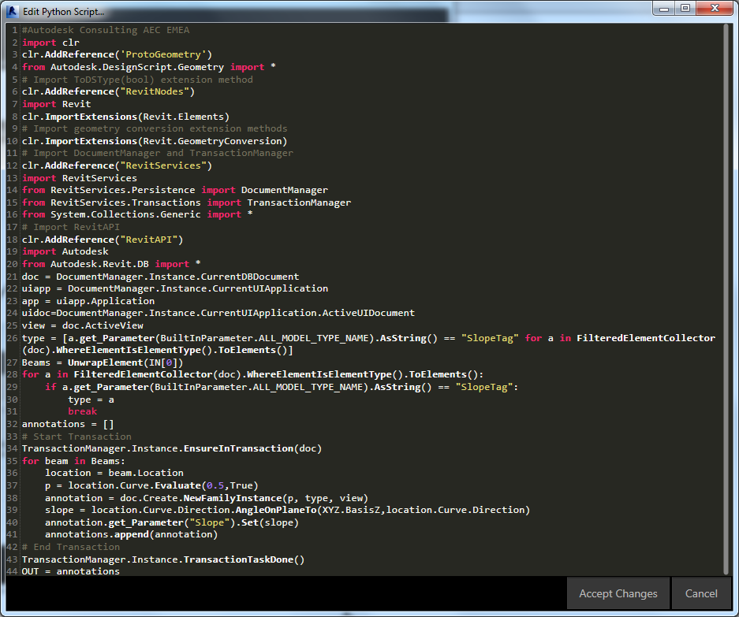
Iron Python 2.7
Embedded IDE
Very simple / no support
.NET compatible
References for Revit API
Revit.Services
Revit.Persistance
RevitNodes
Geometry Conversion
Notes:
Simple to use, very poor support for the writing (no intellisense or debug before the execution).
Special references needed to handle the Revit API, in particular
A TransactionManager that handles the transaction context so that the while Dynamo graphs run into one transaction and performs the Rollback() in case of an error or a crash
Geometry conversion that can translate Dynamo geometry objects into Revit geometry object (for instance in Dynamo Point and Vector are two distinct objects but for Revit they are treated the same way as XYZ objects)
RevitNodes that can translate the DynamoRevit objects into Revit objects (the names may be the same but the classes in DynamoRevit don’t necessarily have the same methods and properties
Python script let the user have a better and more complete experience and can integrate more of the API.
Adding the right references makes possible to interact with other software platforms (such as AutoCAD).

Slide 31
Backup
Introduced in 0.8.2
Creates a Backups folder in which stores the previous versions of the Dynamo graphs at the same path
Accessible from the Home view
It is possible to set the interval between two backups

Slide 32
Autodesk Standards

Slide 33
Coding Standards | Naming Convention
Reflect Repository Structure
Explicit binding with Revit models
Enable Searches
Drive sorting for Dynamo Player sequences
Use Notes to add detail to the graph
Rename key nodes in the graph appending a description
<Name> | <Description>

Slide 34
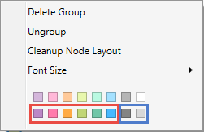
Coding Standards | Color Coding
Adopt existing standards (i.e. Autodesk)
Provide guidance to create graphs and improve readability
Development and maintenance can be picked up by someone else following the same rules

Slide 35
Coding Standards | Templates
Graph General Info and search keywords
Instructions
Known Issues and Limitations
Notes for Input and Output data structure and variable type for scripts
Python and DesignScript templates (i.e. Notepad++)
Clean Node Layout

Slide 36
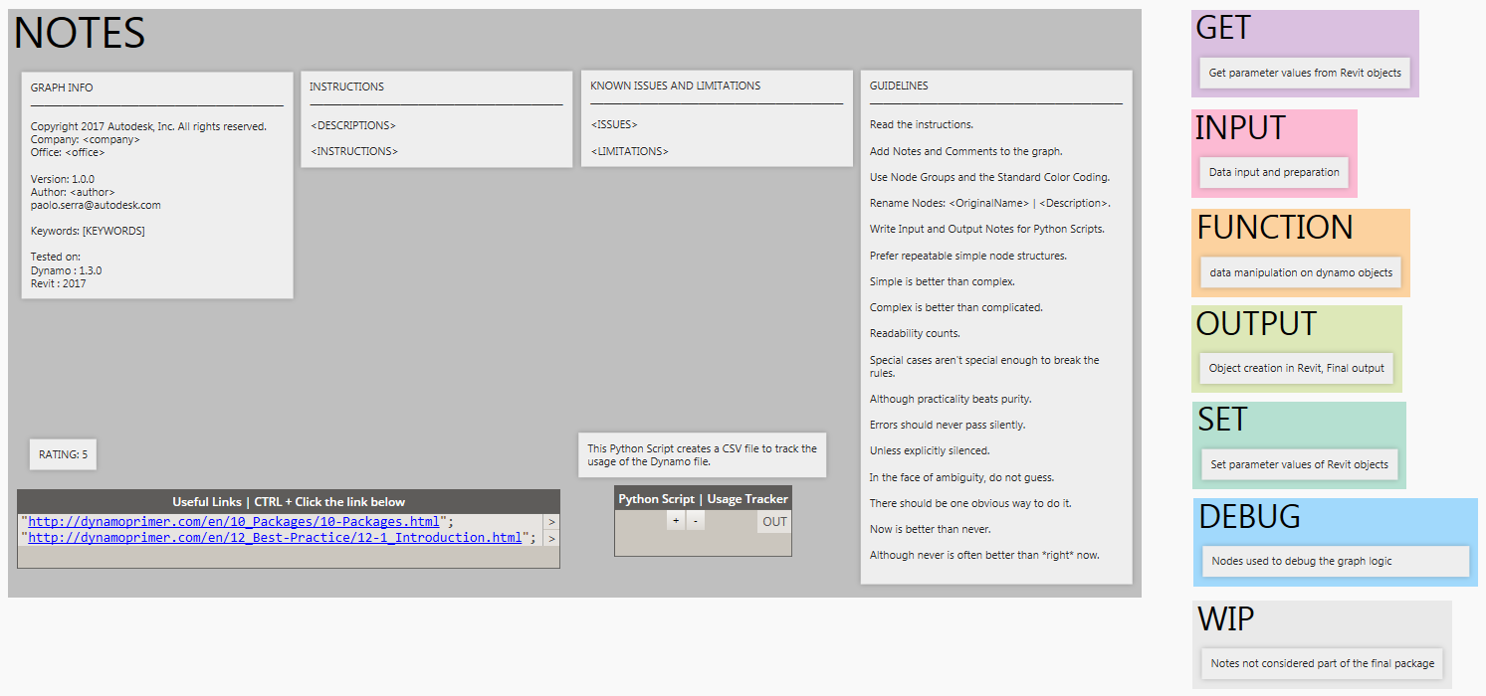
Coding Standards | Autodesk Template
Notes:
Graph Usage Tracker
Rating score for graph recommendation
Links to external references

Slide 37
Coding Standards | Custom Nodes
Avoid custom nodes in the graphs to be shared
Use Helpers to collect and recall frequently used node structures
Organize the nodes in categories

Slide 38
Coding Standards | Helpers
Enable searches in the Library
Enforce Standards
Reduce time to compose graphs
Easier to maintain and update

Slide 39
Coding Standards | Packages Policy
Avoid relying on external packages
Create package to control source and distribute approved functionalities
Use Node To Code feature before deployment to reduce the risk of connectors being moved
Restrict writing rights to Dynamo User Group only
Enforce mirroring on local machines overnight
Zero Touch is another option to preserve IP (advanced)

Slide 40
Visual Programming

Slide 41
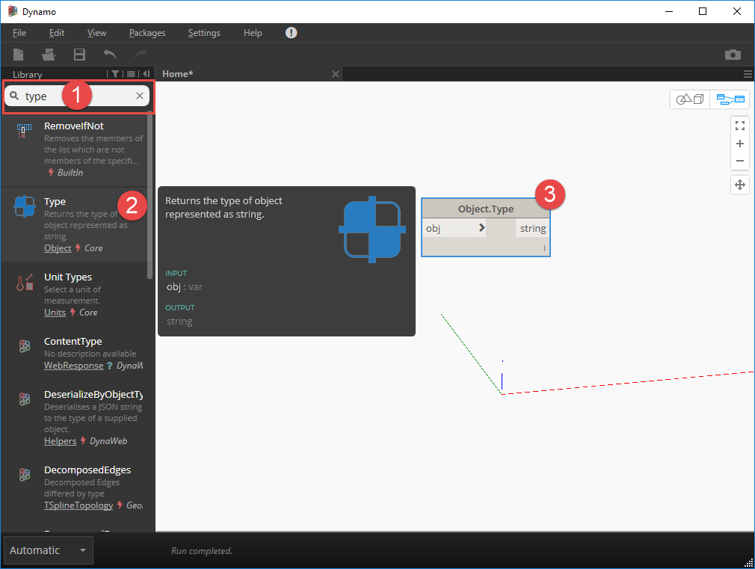
Variable Types
Integers
Doubles (with a decimal part)
Strings (texts in between speech marks)
Boolean (true or false)
Lists (indexed zero-based collections of items)
Dictionaries (in Dynamo 2.0)
Objects

Slide 42
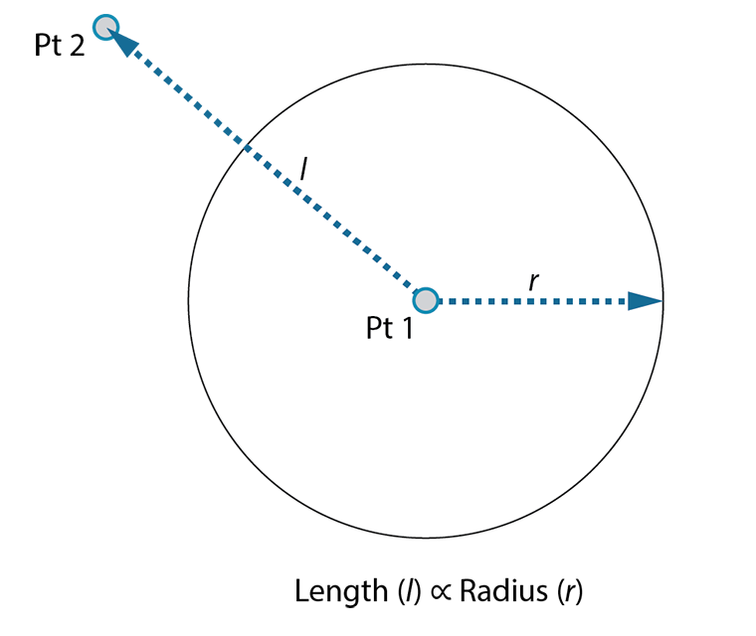
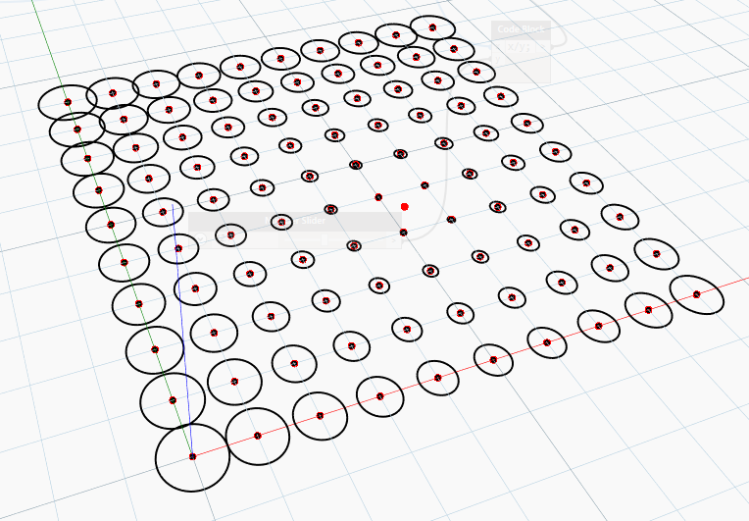
Defining Objectives & Relationships
Notes:
File: Example 01.dyn
Adding complexity
Starting simple and building complexity is an effective way to incrementally develop

Slide 43
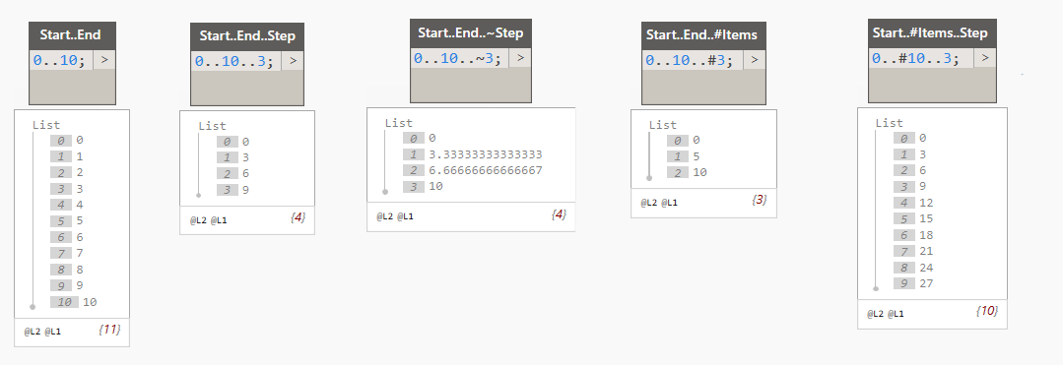
Number Ranges
Start..End; a bounded range of numbers (ending value is included)
Start..End..Step; a bounded range of number with step (the ending value may be not included in the output)
Start..End..~Step; a bounded range with an approximate step (values are evenly distributed, ending value is included)
Start..End..#Items; a bounded range of a given nr. Of items
Start..#Items..Step; a sequence with step and nr. Of Items

Slide 44
Lists
{ a, b, c}; declares a list in Code Blocks, items separated by commas “,”
List[n]; returns the element in the list at the index n, if n is negative the count starts from the end of the list
List[n][m]; returns the element in a sub-list at the index m of list n, if n is negative the count starts from the end of the list
List[{i, j, k}]; returns the elements in the list respectively at position i, j and k
List[n..m]; returns the elements in the list between the indices n to m
Flatten(List); returns a list with the same amount of elements but without sub-lists
Create Sub-lists, Chop lists, etc.

Slide 45
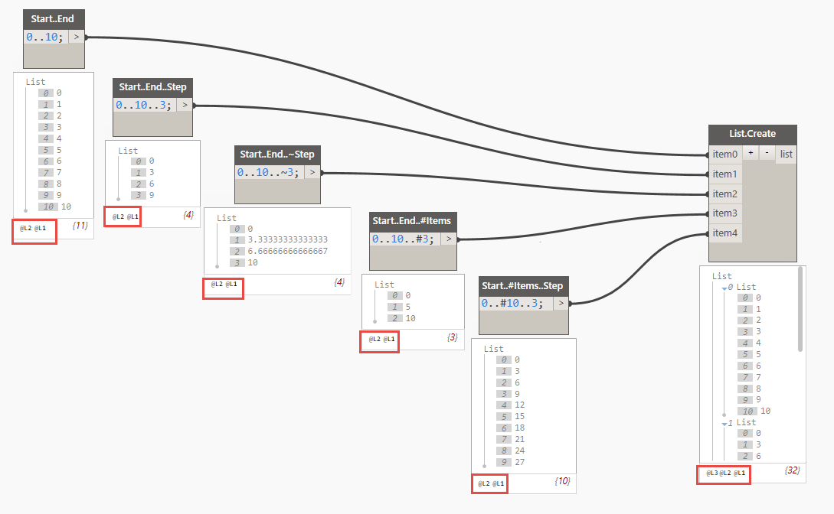
List of Lists

Slide 46
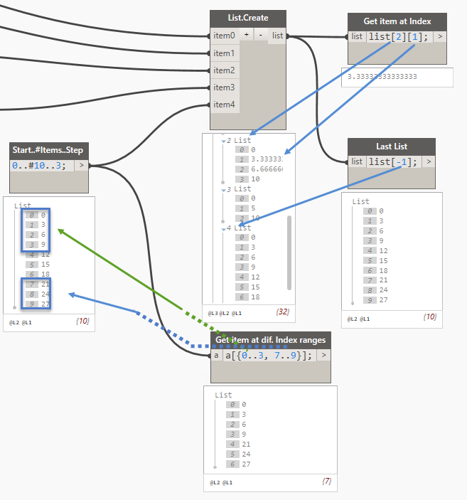
Get Items at Index

Slide 47
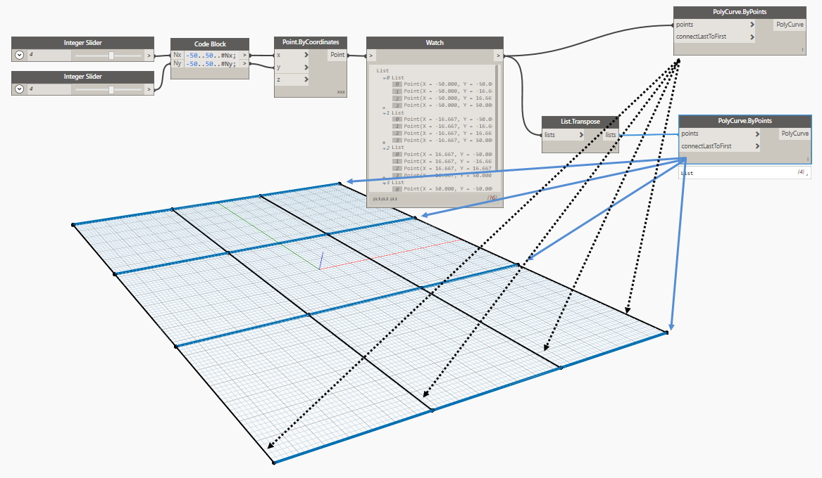
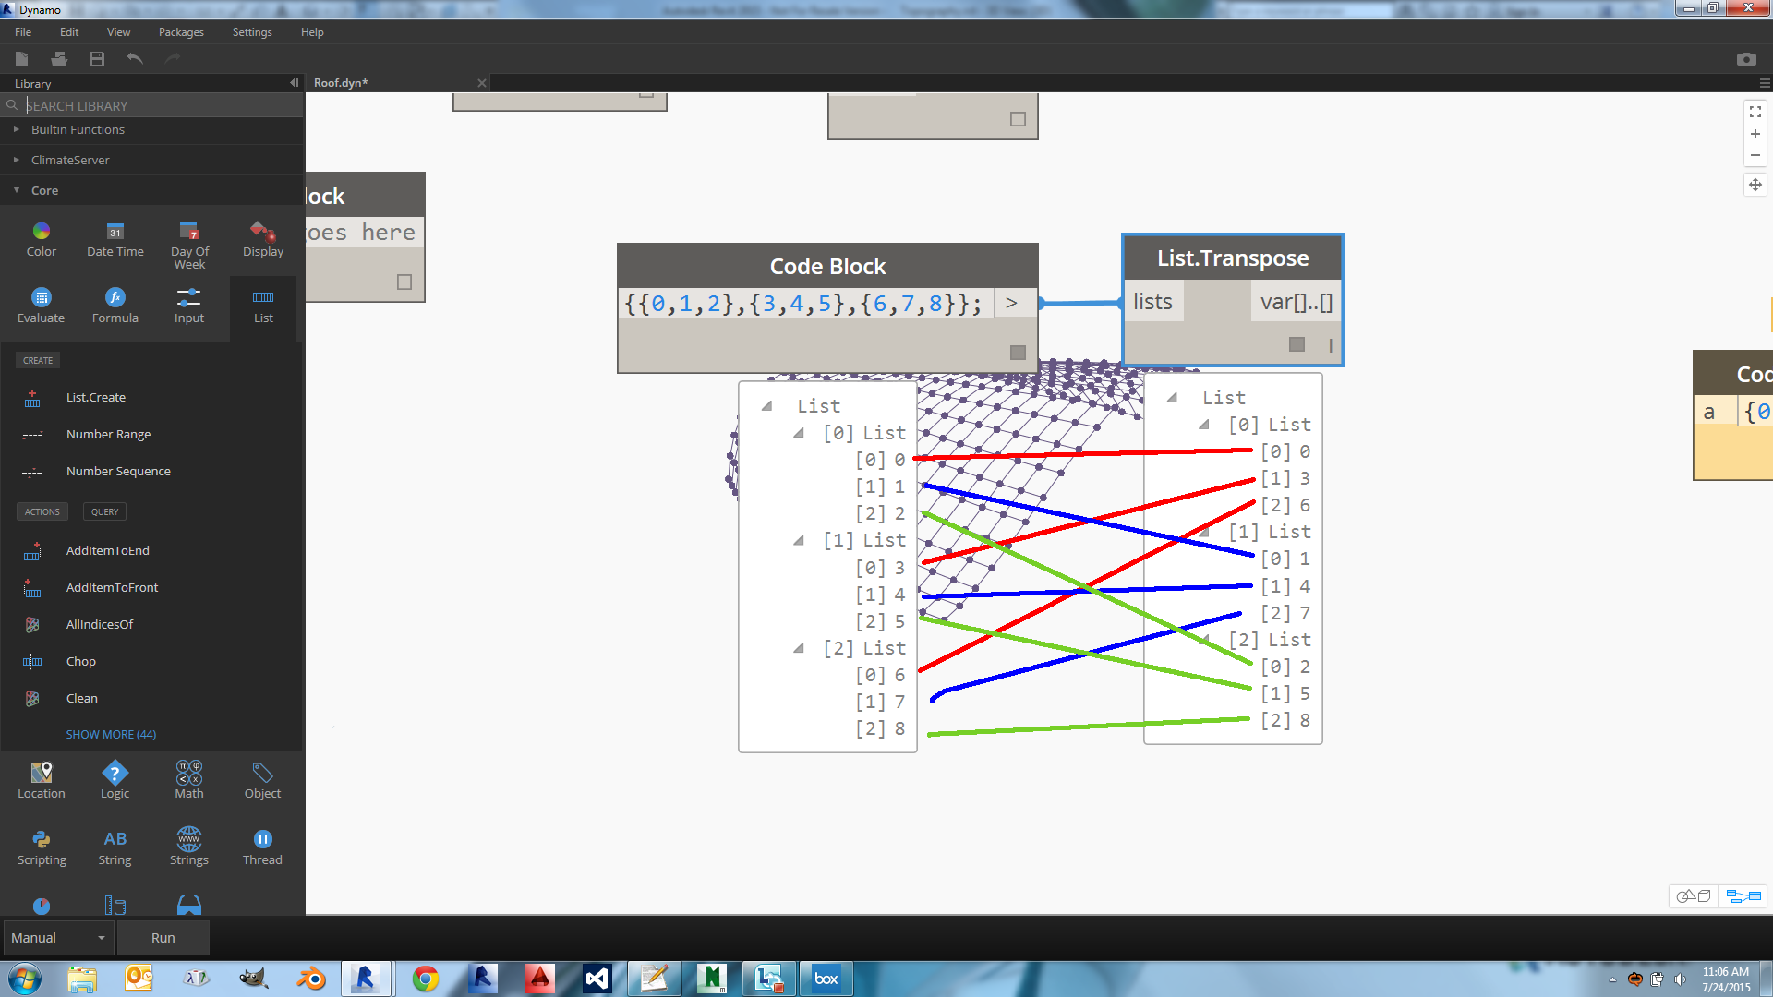
Transpose List of Lists
When transposing a list of lists the data structure changes so that all elements at the same index in each sub-lists are grouped together in the output

Slide 48
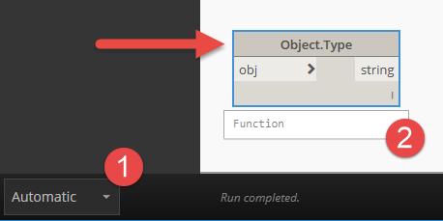
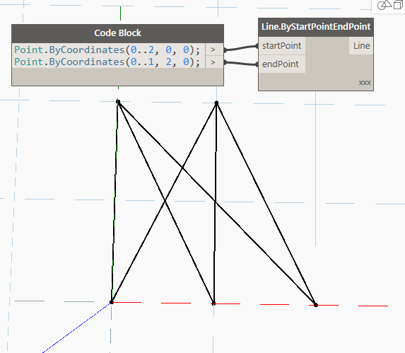
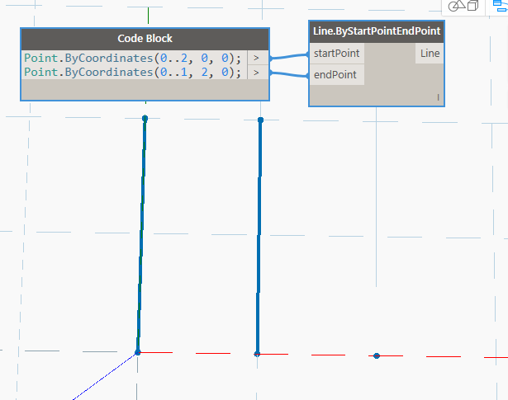
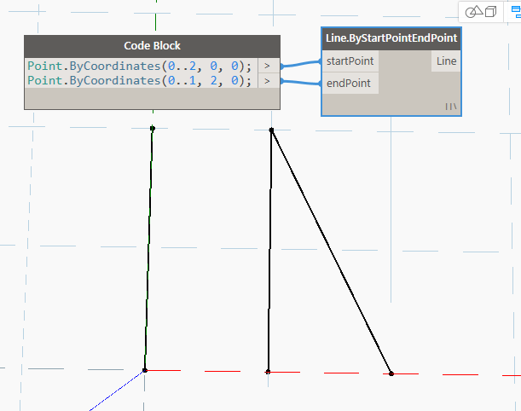
Lacing Strategy
Each node is a function and can iterate over a list of inputs, this is how Visual Programming handles loops
If the provided inputs have different lengths, the lacing strategy on the node is used to combine the inputs as function arguments
The lacing affects the structure of the output
Lacing Strategies
Shortest
Longest
Cross Product
Notes:
Shortest: or “Zip”, the number of items in the output will match the one in the shortest list of inputs, the execution combines elements at the same index position in all the list, it stops when it reaches the last item in the shortest list.
Longest: the number of items in the output will match the one in the longest list of inputs, the last item on the shortest list will be used to complete the execution over the remaining items in the longest input.
Cross Product: Each item in an input list is combined with the items of the other input lists, the number of items in the output is equal to the product of the number of items in the input lists

Slide 49
Filtering, Grouping and Sorting

Slide 50
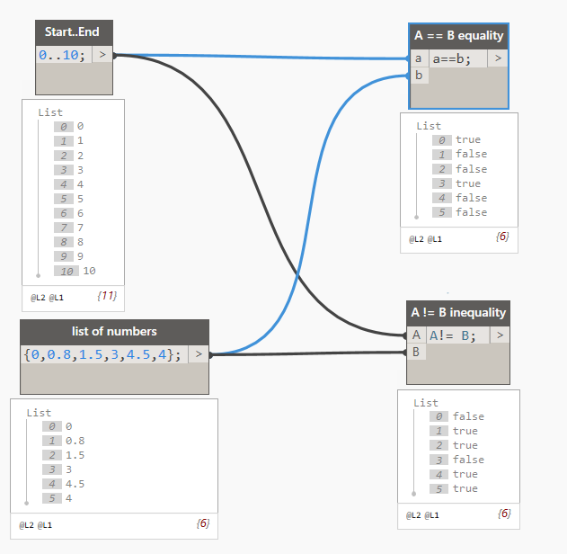
Boolean Expressions in Code Blocks
A == B equality
A != B inequality
A < B less than
A <= B less than or equal to
A > B greater than
A >= B greater than or equal to
&& logical AND (true only if all the arguments are true)
|| logical OR (true if at least one argument is true)
Notes:
Instructions:
Create two ranges: 0..10; and {0,0.8,1.5,3,4.5,4};
Create these Boolean Expressions with these ranges

Slide 51
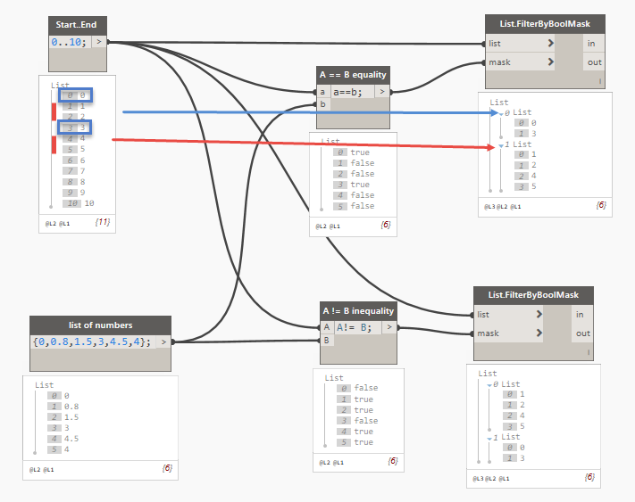
Filter By Boolean Mask
true : in = false : out

Slide 52
Grouping
Grouping by Key
Creates sub-lists grouping the items based on a sequence of keys
Grouping by Function
Creates sub-lists grouping the items based on the results of a function applied to the items

Slide 53
Sorting
Sorting by Key
Reordering the items in a list based on a sequence of keys
Sorting by Function
Reordering the items in a list based on the results of a function

Slide 54
Dynamo-Excel Link

Slide 55
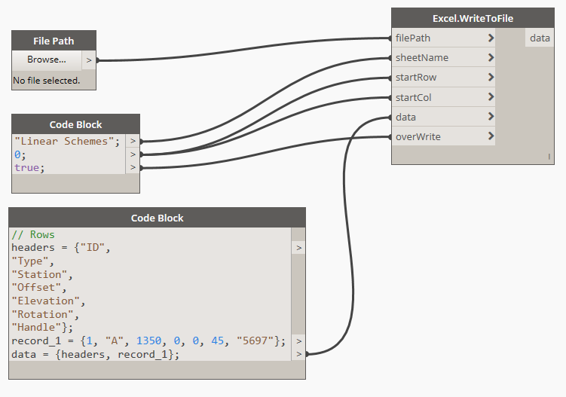
Write to Excel
Specify the file path including the extension
Specify the target tab name
Specify the starting cell with row and column index
Create the data by rows
Specify behavior (create new or update)
Excel will start automatically
It is possible to write to multiple tabs at a time

Slide 56
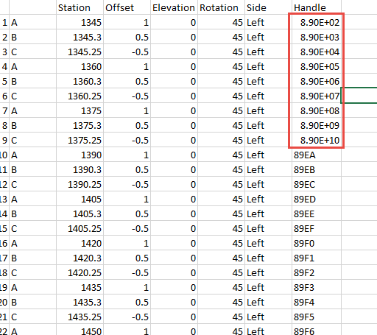
Write to Excel | NOTE
Pay attention to Hexadecimal values (i.e. those used for AutoCAD Handles) as Excel gets easily confused with the 10^ notation
Use String.Insert and use the quotes to make sure the values are passed as strings in Excel

Slide 57
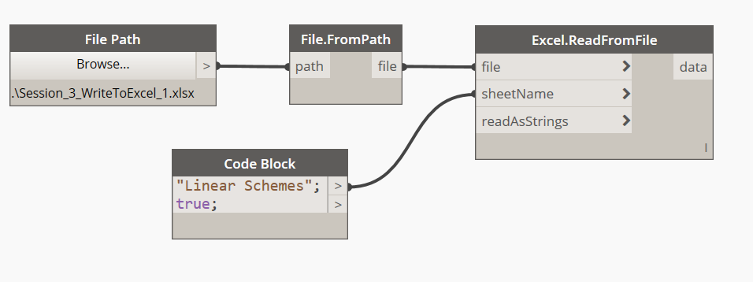
Read from Excel
Specify the file path (string)
Create a data stream in the memory (File object)
Specify tab to read the data from
Read As Strings will convert all the data to text
Excel will start automatically
Use Deconstruct to split the headers
Use Drop Items for a custom # rows to skip

Slide 58
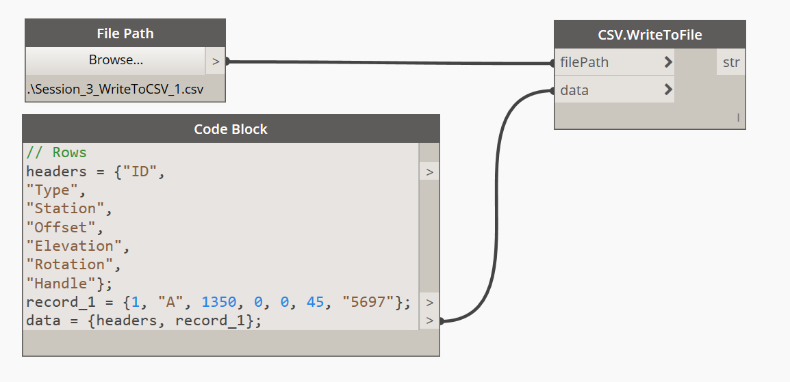
Write to CSV
Similar to Excel but there are no tabs, rows or columns
There is no output of the node
Excel does not start

Slide 59
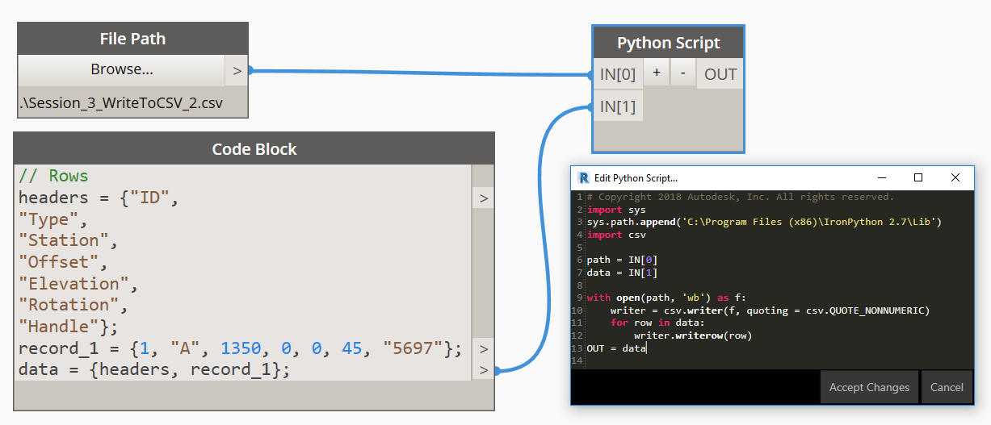
Write to CSV | Python
Fidelity of data types

Slide 60
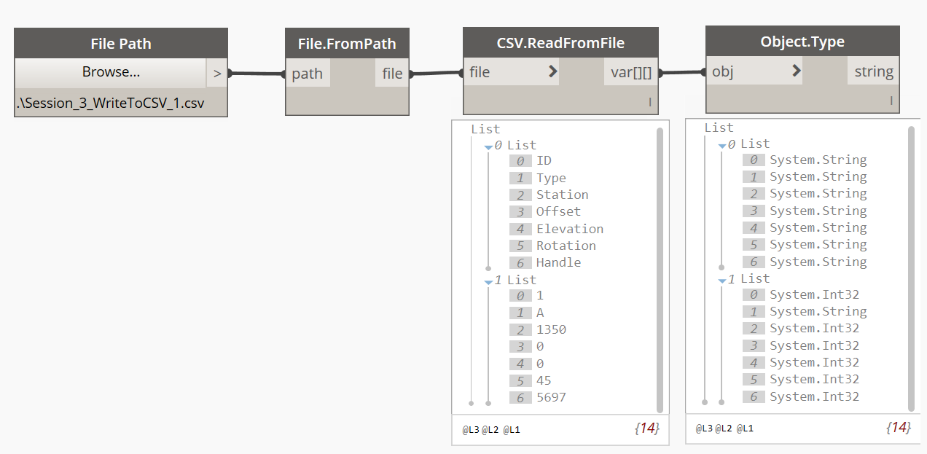
Read from CSV
Specify the path (string)
Create the data stream in the memory (File)
Read content by rows

Slide 61
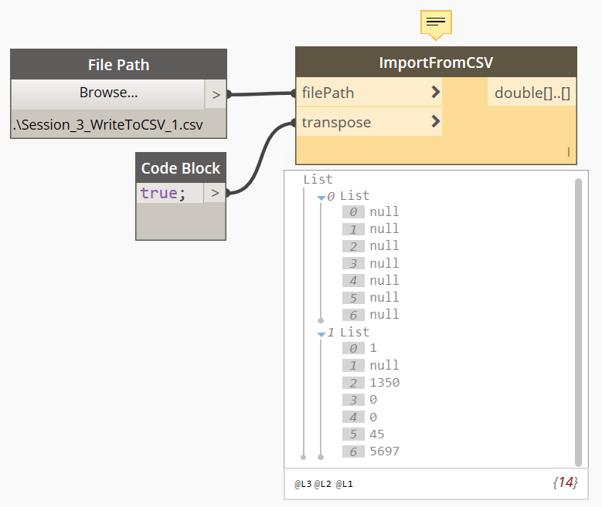
Import from CSV
Specify the path (string)
True reads content by rows, false by columns
Does not convert strings

Slide 62
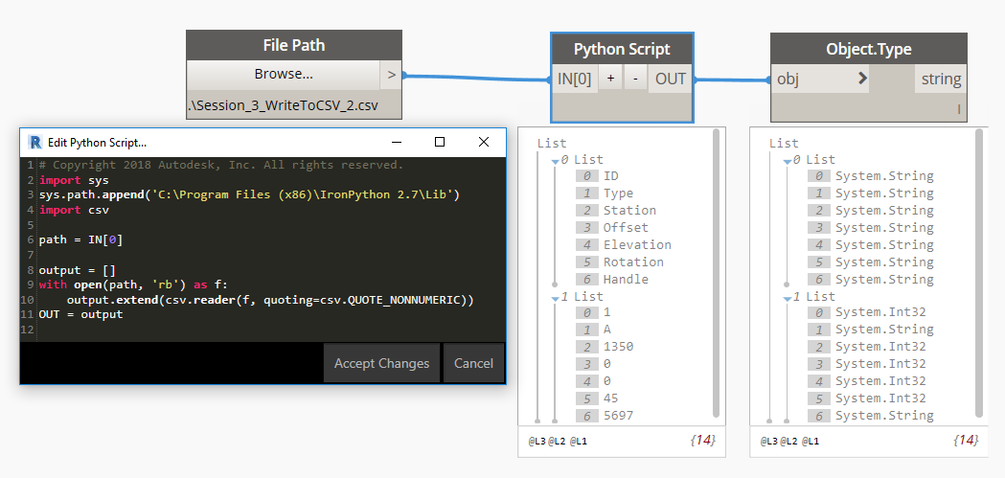
Read from CSV | Python
Specify path, fidelity of data type

Slide 63
Design Script

Slide 64
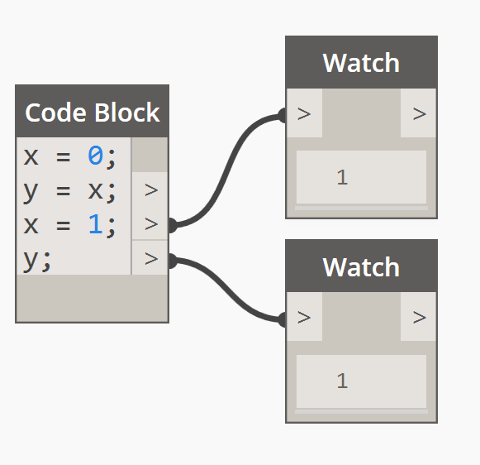
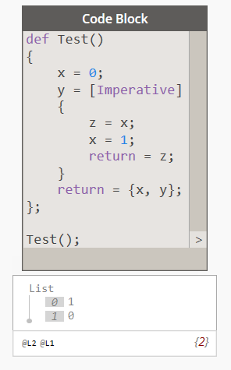
Language Blocks
Associative
Imperative (traditional scripting)

Slide 65
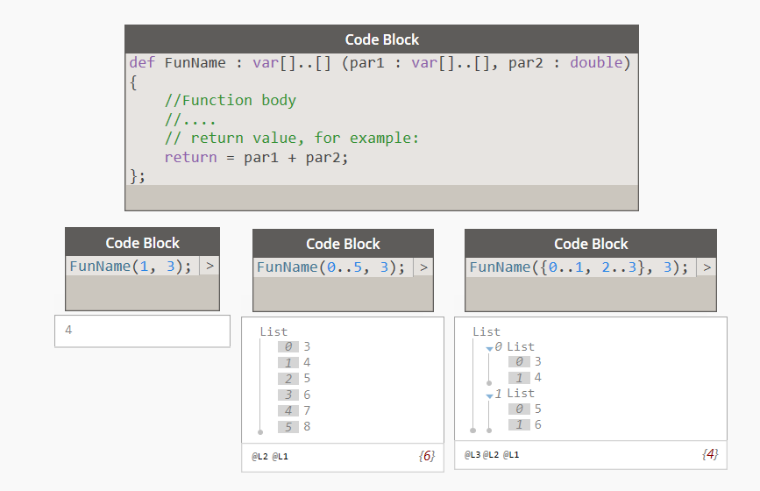
Custom Functions
def keyword, Name with Pascal case, output and parameters rank and types, can be called in other CBs

Slide 66
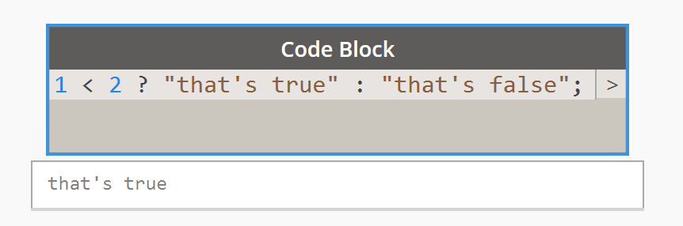
Conditional Statements
Ternary operator, in line conditional statement
Boolean test ? Return value if true : Return value if false

Slide 67
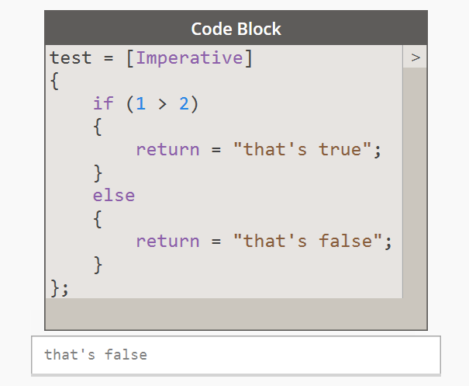
Conditional Statements
If / Else only available in [Imperative] language block

Slide 68
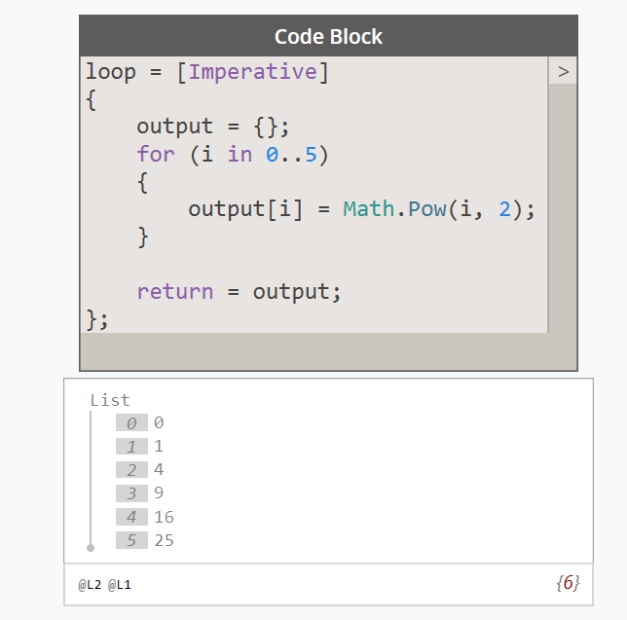
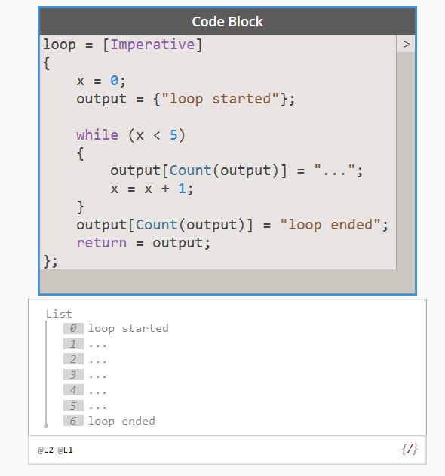
Loops
For / While only available in [Imperative] language block

Slide 69
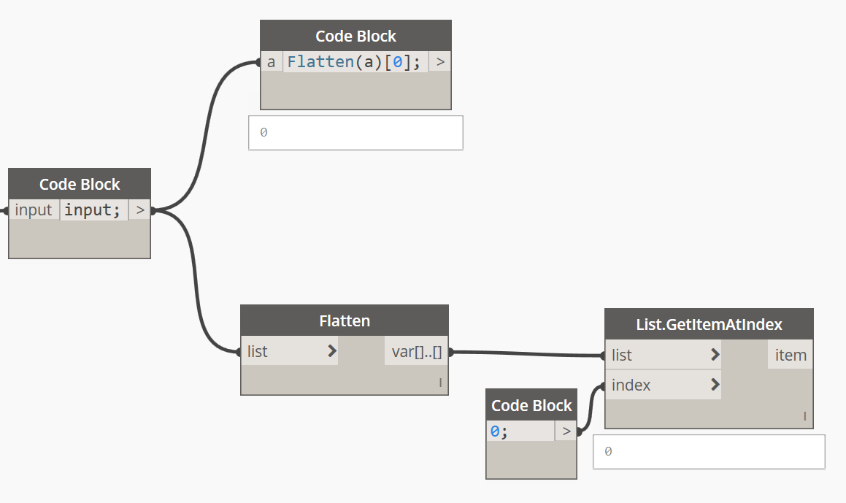
Design Script Syntax
Dynamo nodes are functions, they can called in a Code Block by name
The input ports on nodes represent the arguments of the functions
Retrieve an element from a list at position “n”:
x = list[n];

Slide 70
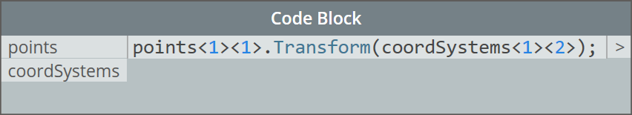
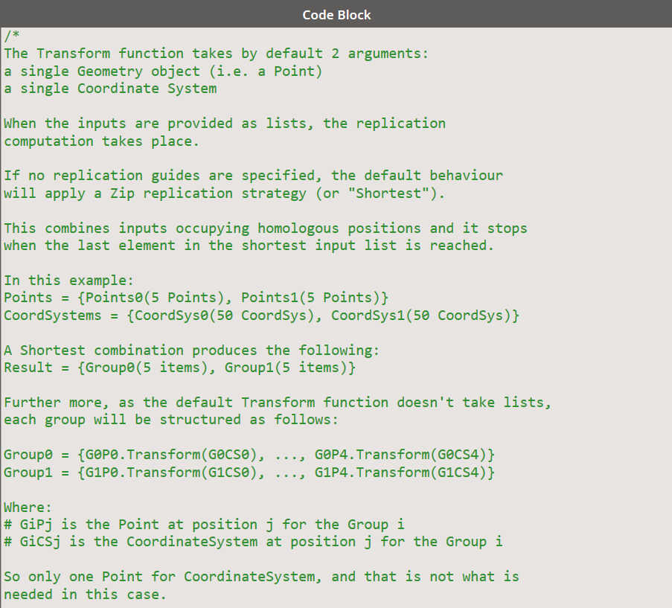
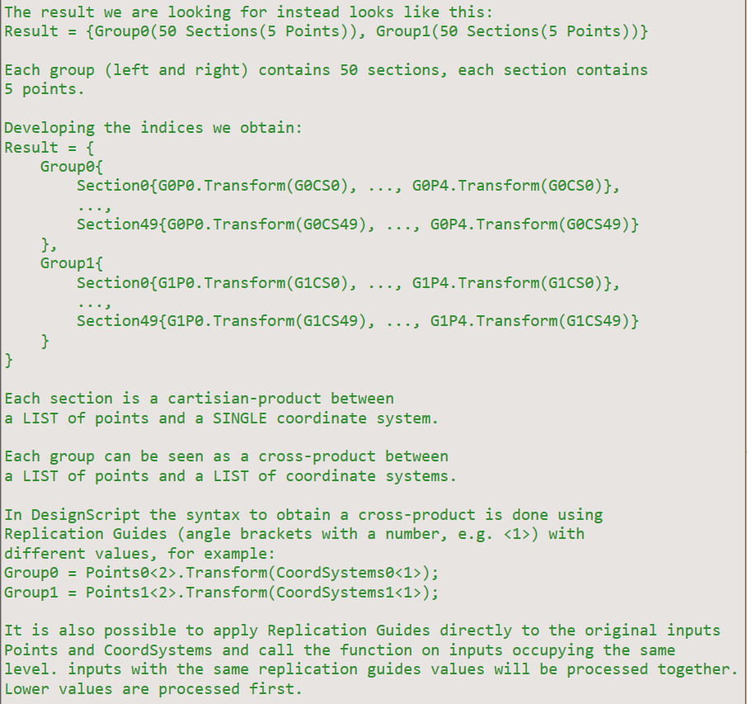
Design Script Syntax

Slide 71
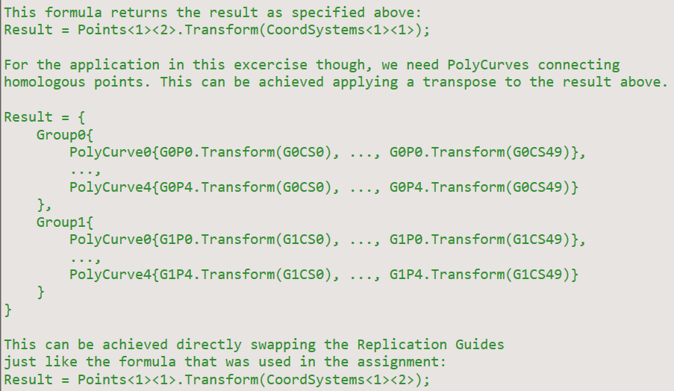

Design Script Syntax

Slide 72
Replication
Visual programming technique to represent iteration
Nodes can accept a list in place of a single value
Doing some operation for all elements in a set for a certain number of times where each operation runs independently
Replications can be nested and create an extra level in the output list

Slide 73
Rank
Integer number that represents the dimensions of a list
Point rank 0
Point[] rank 1
Point[][] rank 2
Point[][][] rank 3
Point[]..[] arbitrary rank

Slide 74


Replication Computation
Cartesian, iterates through all the elements in an input
Zip, iterates through two or more inputs simultaneously and executes the node with these elements together with other inputs

Slide 75
Replication Computation
Depends on the difference between the ranks of the argument (input) and the parameter the node expects (internal function)
Dk = Ak – Pk (skip arbitrary rank)
Loop until Dk = 0
If there are 2 or more Dk > 0 do Zip and decrease Dk by 1
If there is 1 Dk > 0 do Cartesian and decrease Dk by 1

Slide 76

Replication Guides
Applications
When the lengths of the arguments are not the same
Control the Cartesian Replication order
Append one or more <n> or <nL> to the arguments
Different replication levels
Levels enforce iteration
Processed before replication happens
At a given level sort the replication guide values
Apply Zip for equal values and Cartesian for the rest
If all values are different is a Cross product

Slide 77
Geometry Library

Slide 78


Trigonometry
Create a range: 0..360..10;

Slide 79

Geometry Objects

Slide 80

Dynamo Geometry Types

Slide 81

Vectors, Planes, and Coordinate Systems
Notes:
Vectors, Planes, and Coordinate Systems make up the primary group of Abstract Geometry Types. They help us define location, orientation, and the spatial context for other geometry that describe shapes.

Slide 82


Vector
Notes:
If the idea of relative difference is confusing, think of the Vector AB as "I'm standing at Point A, looking toward Point B." The direction, from here (A) to there (B), is our Vector.

Slide 83

Plane
Notes:
Planes are two-dimensional abstract "Helpers." More specifically, Planes are conceptually “flat,” extending infinitely in two directions. Usually they are rendered as a smaller rectangle near their origin.
each Plane has an Origin, X Direction, Y Direction, and a Z (Up) Direction.

Slide 84

Coordinate System
XYZ = RGB
Notes:
Although they are abstract, Coordinate Systems also have an origin position so we can locate them in space.
In Dynamo, Coordinate Systems are rendered in the Background Preview as a point (origin) and lines defining the axes (X is red, Y is green, and Z is blue following convention)

Slide 85

Points

Slide 86

Curves
Notes:
Line
Polyline
Arc
Circle
Ellipse
NURBS Curve
Polycurve

Slide 87

NURBS + Polycurves
Notes:
NURBS (Non-uniform Rational Basis Splines) are mathematical representations that can accurately model any shape from a simple two dimensional Line, Circle, Arc, or Rectangle to the most complex three-dimensional free-form organic Curve.

Slide 88


Surface
Notes:
Surface
U Isocurve
V Isocurve
UV Coordinate
Perpendicular Plane
Normal Vector
Surface is a mathematical shape defined by a function and two parameters, Instead of t for Curves, we use U and V to describe the corresponding parameter space. This means we have more geometrical data to draw from when working with this type of Geometry. For example, Curves have tangent vectors and normal planes (which can rotate or twist along the curve's length), whereas Surfaces have normal vectors and tangent planes that will be consistent in their orientation.

Slide 89

Solids

Slide 90


Boolean Operations

Slide 91
Automation Applications

Slide 92




Excel Interoperability
Data Transfer Tool

Slide 93

Revit – Data Mining
Notes:
Access the Revit database and extract object parameters and geometry information to pass to another platform.
In this example accessing to the analytical model of a complex roof structure to pass the information in a structural analysis software mapping the ElementIds and no extra plug-in required.

Slide 94

Computational Design

Slide 95

Access Open Street Map Data
Notes:
ELK package contains Methods to access ESRI API and allows to read OSM files into Dynamo and create geometric entities that can be reused in Revit for example

Slide 96

Revit – Model Authoring
Notes:
Starting from the selection of two wall edges it creates a surface controlled by a formula.
On this surface are placed curtain wall panels with an arbitrary subdivision pattern, it can be controlled with a formula, doesn’t have to be a regular distribution.
Structural framings follow the surface creating a grid and the shortest diagonal, each member has a rotation angle to orient like the surface.
Changing the input it updates the model in a few seconds.
This approach makes the study of multiple options possible and it introduces the concept of parametric design as a tool to understand how a model works.
For more advanced applications using the Revit API:
Create Revit filters programmatically based on objects properties
Set object properties based on calculations done in Dynamo
Edit the content of Linked files directly from the host file

Slide 97



Revit – Fixed Dimensions Panels on Surface

Slide 98

Revit – Rebar (2016+)

Slide 99

Robot Structural Analysis – React Struct

Slide 100

Revit – Drawing Production
Notes:
Workflow that creates the sheets in a drawing list starting from an Excel spreadsheet that can populate the spreadsheet reading the Revit file content.

Slide 101

Revit – Drawing Production
Notes:
Another workflow generates the internal elevation views per each room in the selection set, creates a sheet per room and places all the related views on. (C-Sheet requirement, especially for hospitals, to show where specialty equipment and fixtures are laid out on the walls).

Slide 102


Revit – QR Codes for Asset Management
Notes:
Takes advantage of a free Google web service to create QR Codes images based on the ElementId values of the object and store the image back in the model.

Slide 103

Shape Analysis
Notes:
Derive the construction profiles from a 3D model to validate the design, shop drawings and model content creation

Slide 104

3D Coordination
Notes:
DynaWorks package nice use of Custom nodes with the Zero Touch Essentials principle.
Start a silent session of Navisworks and run clash detection on models.
The result can be analyzed and used to create views of the clashes or place families to review the design in Revit directly.
Revit users love this because they have the experience of being using their favorite tool all the time while they are taking advantage of several tools in the suite at once.

Slide 105

AutoCAD-Revit
Notes:
Via API and Python it is possible to drive AutoCAD from Dynamo and exchange data, Latest release of Dynamo Studio can also read DWG files natively

Slide 106



Civil 3D
Notes:
Via API and Python it is possible to drive AutoCAD from Dynamo and exchange data.

Slide 107
Dynamo for Revit

Slide 108
Select Revit Elements
Pick an object (instance, face, edge)
Window select many instances at once
Select All Elements By a common characteristic (element type, category, family type, level)

Slide 109
Get Parameter Value By Name
Revit objects (families, views, family types, etc.) are all ELEMENTS and they all have a specific set of PARAMETERS
A parameter is a container with a name and a value
The value the user is presented may be different from the one stored internally in Revit (use Revit Lookup add-in for more detail)

Slide 110
Set Parameter By Name
Each parameter has a specific Storage Type and a specific range of values that can actually be assigned
Use the Revit Lookup and the Revit SDK for more details
When using Dynamo you don’t need to worry about the unit conversion for the parameter value

Slide 111
Create Revit Elements
The geometry entities in Dynamo can define the location or the geometrical definition of Revit objects (points for family instances, curves for walls and structural framings, closed loops for slabs, etc.)
Once created the elements are persistent for the Revit session (even closing and reopening Dynamo) but closing Revit will definitely break the tie
First create the element, then change its parameters

Slide 112
Revit Coordinate Systems

Slide 113
Revit Coordinate Systems
Implicit coordinate systems
Internal (not visible)
Local Coordinate System -> Project Base Point
World Coordinate System -> Survey Point

Slide 114


Project Base Point
Visible under Site category
It is always parallel to the screen sides
Contains an angle value
NEVER unclip

Slide 115


Survey Point
Visible under Site category
It is always parallel to the World Coordinate System
If it remains clipped identify the Origin of the WCS

Slide 116
Internal Coordinate System
All the objects created through the API or Dynamo are referring to the Internal Coordinate System
By Default the Project Base Point is sitting on top of the Internal origin, that is why the PBP should never be unclipped

Slide 117
Shared Sites
It is possible to define multiple site locations and orientations for the same project document
These are called shared sites or named locations
These allows to coordinate multiple files to each other

Slide 118

Manage multiple shared sites

Slide 119
Linking RVT with multiple shared sites
Every instance of the RVT link can be set to a particular shared site
Select the link
Enable the shared coordinates
Select the proper shared site

Slide 120

Total Transform & Coordinate System
In Dynamo terms the Revit Shared Sites are Coordinate Systems objects that transform the coordinates from the local origin to the WCS and vice versa
Extracting point coordinates from Revit or reading point coordinates from Excel require transformation

Slide 121
Dynamo & Python

Slide 122
Python
PROs
Easy to understand and maintain, simple and yet powerful
Ideal for prototyping and learning
Productive and flexible
Large users community
Many custom modules
Present in Dynamo
CONs
Not intended for compiling (interpreted language)
Speed can be an issue > PyPy
Debugging can be cumbersome (errors show up at runtime only)
A lot of white space due to indentation
Not officially supported for API

Slide 123
Python Learning Resources
Iron Python Documentation installed on your machine
Courses online learning platforms
i.e. Lynda.com
Many blogs
i.e. http://planetpython.org/
Many videos on YouTube
AU lessons and handouts
http://www.revitapidocs.com/code/

Slide 124

Python Script Nodes
Two nodes to use Python scripting
Load .NET namespaces
Access Revit API in process
More on DynamoPrimer.com
Tip
Use an external editor and then copy and paste the code in the node
Create your own modules to expand the functionalities

Slide 125

Python Editors
PyCharm
Sublime Text
Visual Studio / Visual Studio Code
Atom
Spyder
Ninja Python
…
PEP 8 / PEP 257 for coding style

Slide 126

Python Syntax
Being consistent with the indentation is very important
“Soft” Tabs: when the user presses the TAB key the editor places a number of spaces instead (usually 2 or 4)
Breaking lines is allowed in Python but it can lead to mistakes

Slide 127

Python Script Nodes
The inputs have the key “IN[#]” that reflects the node interface
They cannot be changed to report a different name on the UI
The output has the key “OUT” that reflects the node interface
It cannot be changed to report a different name on the UI
Use notes to describe the input and output structures and data types

Slide 128

Iron Python | .NET Compatible
Interpreted Programming Language (no need to compile)
Statement grouping via indentation
IronPython 2.7.3 installed with Dynamo
.NET capabilities (i.e. Revit API)

Slide 129

Syntax
Case sensitive
# at the start of the line is a single line comment
“””…””” comments multiple lines in between
End of the line is the end of statement
Indentation can be done using spaces or tabs at the beginning of the line
Add spaces for readability (i.e. x = 2 + y)

Slide 130
Variables
The name of a variable is a pointer to a location in the memory
A variable must be declared before it can be used in a given scope
The = sign is used to assign a value to a variable
The same variable can refer to different data types
Keywords are not allowed as variable names and they are usually highlighted in the editor

Slide 131
Data Types
Integers : int (i.e. 1)
Numbers : float (i.e. 1.0)
Strings : str (i.e. “1.0” or ‘1.0’)
Booleans : True / False (i.e. 2 > 1)
Null value : None
…

Slide 132

Data Types
Dynamo
Integers (i.e. 1)
Numbers (i.e. 1.0)
Strings (i.e. “1.0” or ‘1.0’)
Booleans (i.e. 2 > 1)
Null
…
Python
int
float
str
True, False
None
…

Slide 133
Boolean Operations
not A : negates A
A and B : True only if all the arguments are True
A or B : True if at least one of the arguments is True
A == B : equality
A != B : inequality
A < B : less than
A <= B : less than or equal to
A > B : greater than
A >= B : greater than or equal to

Slide 134
Collections
Zero based collections of values
Array / List defined via [ , ]
Typed Array defined via Array[ T ]( [ ] ) where T is the type
Tuple defined via ( , )
Set defined via set()
Dictionary defined as { key1 : value1, key2: value2, … }
Get an object from a collection knowing its indexed position or its key:
alphabet[2] = “c”

Slide 135

Conditional Statements
if Test :
# do something
elif newTest :
# do something different
else :
# final case

Slide 136

Loops | While
Repeat instructions in the body until a condition is met
while Test :
# do something
The loop will break only when the Test returns False
It is very easy to make a mistake and create infinite loops

Slide 137

Loops | For
Traverse a list and repeat the instructions a given amount of times
for iterator in collection :
# loop instructions
range() : creates a sequence of numbers in arithmetic progression
len() : returns the amount of elements of a collection
break : exits the smallest enclosing loop
continue : moves on to the next value of iterator
pass : does nothing

Slide 138
Enumerate
for key, value in enumerate(collection) :
# loop instructions
The enumerate() function returns simultaneously a reference to the index of an item in a collection (key) and a reference to its value
This allows to use the same index across multiple collections

Slide 139
Named Function
A function is an object
Set of instructions that can be recalled in the body of the code as many times as needed
Easier to read and maintain
Call itself in its definition (recursion)
Can be used for sorting
Arguments are optional > use defaults
Parameters (definition), Arguments (call)
Return is optional (None)
def fn_name (par0, par1, par2, …) :
# list of instructions
return output

Slide 140
Python Variable Reference
In Python variables are simply names referring to objects in the memory
Arguments passed to functions by reference
Objects can be mutable or unmutable
Mutable: List, Dictionary, etc.
Unmutable: int, str, etc. (hashable)
x = [ ]
y = x
y.append(10)
print ‘X = ’ , x
print ‘Y = ‘, y
Output
X = [10]
Y = [10]
X is the name of the variable point to the object in the memory
Y is a new variable pointing to the same object in the memory
The List is mutable and it is possible to add an item to it
Both X and Y are pointing to the same object in the memory, the value assigned to the variables is the same

Slide 141
Lambda Forms
Anonymous functions
Small functions made of a single expression
Used whenever a function object is required
sorted() Python Built-In sorting function
Optionally lambda forms can be used as key for sorting
Optionally the collection can be reversed
lambda arg0, arg1, arg2, … : # use the arguments
collection = sorted(collection, key=function, reverse = True)
points = sorted(points, key=lambda k : k.X)

Slide 142
Comprehension
Concise syntax to apply filters and functions on a collection of items
It can return:
List []
Tuple ()
Dictionary {}
Very useful in Revit API filtering / sorting
It’s the equivalent of for loops and if statements but in one line
It can be used to “flatten” a multi-dimensional array
a = [ function(i) for i in collection if Test ]
mda = [[0, 1], [2, 3]]
flat = [a for row in mda for a in row]

Slide 143
Context Manager
A construct that safely disposes an object when the focus exists the “with” scope
Used to interact with databases (files, transactions, etc.)
It prevents to do harm to the documents and applications the code in interacting with
with Object as variable :
# do something to the Object
# the Object will be safely disposed

Slide 144
Debugging in Python for Dynamo
Traceback call with a reference to the line containing an Error or Exception
The name of the Exception gives an idea of what the problem might be
Syntax
Functions arguments
Instructions evaluation
Input values

Slide 145
Try / Except
The instructions in the “try” scope may fail
The “except” scopes can be introduced to catch and handle different scenarios
If the error type is not specified, all sorts of errors will be caught (even typos!)
Once the error is handled, the code can continue
try :
# try to do something
except Error1 :
# do this if Error1 is encountered
except Error2 :
# do this if Error2 is encountered
except :
# this catches all kinds of errors

Slide 146

Built-In Exceptions

Slide 147
Operating With Files
Context manager to safely interact with files on the hard drive
OpenMode:
Reading ‘r’
Writing ‘w’ (overrides the content)
Append ‘a’
‘ab+’ means appends with a binary format and it can also read from the source (+)
with open(“filepath”, OpenMode) as f :
# do something
File.readline()
File.write()

Slide 148


Operating with CSV files
csv module included with Python
csv.writer.writerow() takes a list of values and appends a row to the CSV file
csv.reader returns a rank 2 array containing the rows

Slide 149

Operating with XML
Extensible Markup Language
XML Namespace
XML Element
Attribute
InnerText
Notes:
XPath defines the elements in the document
The content is text that may need to be converted

Slide 150

Python XML module | Element Tree
Built-in module xml.etree.ElementTree
Parse a file from source or string
Find elements by tag
Get and Set attributes of existing XML elements
Get and Set elements text
Create new SubElements

Slide 151

Reading and Writing XML | System.Xml
Add reference to System.Xml
XML Namespace, XML Document, XML Element, Attributes
Understand / define the schema to adopt
Select nodes using Tag name or Xpath
Example: reading a Navisworks clash report

Slide 152


Reading and Writing XML

Slide 153

Operating with JSON
Java Script Object Notation
Python built-in module json
It is possible to read and write a file
It supports custom Encoding and Decoding
Very good performance, human readable

Slide 154
Persistence
Serialization of data
Multiple options
pickle (dedicated Python module)
XML
CSV
JSON (very popular for web)
Restore values and objects between executions
It can be used to store the results of expensive calculations and improve performances
Dictionaries are the best structures to read and write data

Slide 155
Object Oriented Programming

Slide 156
Object Oriented Programming
Based on Classes (or types) and Objects (or instances)
Classes
The blue-print of objects from which individual objects are created
Define properties and methods
Can be inherited from other classes
Objects
They all have state (properties) and behavior (methods)
Objects are instances of classes

Slide 157
Object Oriented Programming
Basic principles
Inheritance: parent class and descendants, abstract classes
Polymorphism: code can be called on objects regardless they belong to parent or descendants classes
Encapsulation: access modifier (public, protected, private)
Open Recursion: object methods can call other methods on the same object including themselves (self)
Class Members
Properties define the state of an object
Methods define how an object behaves
They can be called via the “dot” notation
p.X # returns the x coordinate property
p.Add(q) # performs an action on the object

Slide 158
Python Classes
class Person :
“”” Description of the object.”””
def __init__(self, _name, _age) :
self.Name = _name
self.Age = _age
def __repr__(self) :
return ‘Person(Name={0}, Age={1})’.format(self.Name, self.Age)
Initialization Method
Class Definition
Properties

Slide 159
Python Classes
The keyword class defines a class
The keyword self is used to refer to an object (an instance of the class) in its definition
Use the keyword self to refer to properties and methods defined in the class
Define attributes and members to enable common behaviors such as:
String representation
Comparison
Use dir(object) to access the class members

Slide 160
Decorators
A design pattern that takes a function and wraps it into another function
Used to customize the behaviors of class members at runtime
Define read only properties
Define class and static methods
@decorator

Slide 161
Namespaces
An organized collection of classes
Compiled in .DLL files or in the GAC
Defined in Python (.py) files
IronPython add reference
Import classes to make their names available in the code (either all or a subset of those present in the namespace)
Define aliases for disambiguation
import System
from Autodesk.Revit.DB import *
from Autodesk.Revit.UI import TaskDialog, Selection
from Autodesk.DesignScript.Geometry import Point as DSPoint

Slide 162
Python Modules
A Python file can contain multiple classes definitions and can be referenced in another file
__all__ is a list of names of the objects defined in a Python file that are available when using import *
Defining a folder with a name and a __init__.py file defines a Python module
Python modules can be downloaded to expand the available classes (numpy, shapely, etc.)

Slide 163
Python PEP8 Style Guide
Standard for Python code development
Ensures readability
Facilitate maintenance
Helps in understanding better a code
Conventions for naming files, constants, variables, functions, parameters, classes, methods, properties, etc.
Documentation strings to be included in the definitions (__doc__)
Link

Slide 164
Revit API Introduction

Slide 165
Revit API | Resources
Software Development Kit (SDK)
RevitAPI.chm
The Building Coder (Jeremy Tammik)
Revit LookUp add-in

Slide 166
Revit API | Main Namespaces
Autodesk.Revit.DB
Access to the Database object and its children
Document
Elements
Autodesk.Revit.UI
Access to objects that allows the user interaction with Revit
Selection
Messages

Slide 167
Revit API | Application
An object that represents the instance of the Revit application that is running
It contains a reference to the Documents loaded (active projects and links)
It allows to access the Revit application settings

Slide 168
Revit API | UIDocument
An object that represents the current active project presented to the user
It contains the methods necessary to interactively select items, the result is a collection of Reference objects
It allows to present messages to the user via TaskDialog (also useful for debugging)

Slide 169
Revit API | Document
An object that represents a Revit file (project .rvt or family .rfa)
It has properties to define the file (Title, PathName, etc.)
It has methods to retrieve objects and modify the content
GetElement(), FilteredElementCollector(), …

Slide 170
Revit API | Element
The base object for most of the Revit items (inheritance and polymorphism)
Instance
ElementType
Wall
…

Slide 171
Revit API | Parameters
Every Element object has a specific set of properties that help describe the object in more detail
They can be Built-In or added via Shared Parameters file
Object parameters are retrieved not in any particular order so it is important to be able to filter and sort them

Slide 172
Revit API | Parameters
Parameters value can be read-only and of a specific data type (StorageType)
The internal units may differ from the Display Unit Type
To set parameter values there is need for an open Transaction

Slide 173
Revit API | Transaction
Allows to safely access to the Document database
The name in the “undo” history
The transaction can Start, Commit if successful or Rollback if not
In Python use the with statement to be sure to handle the database correctly

Slide 174
Transaction example
with Transaction(doc, “TransactionName”) as t :
t.Start()
# do something
t.Commit()
Transaction.Rollback() restores the Document to the same state as before the Transaction started.
If the code fails in the with scope Rollback is used.

Slide 175
Revit API | Transaction Groups
An object to execute multiple Transactions without cluttering the Undo commands list
The transaction can Start and Assimilate the internal Transactions
In Python use the with statement to be sure to handle the database correctly

Slide 176
Transaction Group example
with TransactionGroup(doc, “GroupName”) as tg :
tg.Start()
with Transaction(doc, “TransactionName”) as t:
t.Start()
# do something
t.Commit()
t.Start()
# do something else
t.Commit()
tg.Assimilate()

Slide 177
Revit API | Create
Document.Create for project
Walls
Floors
FamilyInstances
…
Document.FamilyCreate for family
Extrusions
Sweeps
Lofts
…

Slide 178
Revit API | GeometryElement
To create, change or delete a geometry object in Revit API it is not necessary to open a Transaction
GeometryElement is the geometrical representation of a Revit object
An element can contain more than one GeometryObject

Slide 179
Revit API | GeometryObject
Quite often in Revit API it is necessary to create the GeometryObject that defines a Revit object to create it
The kind of GeometryObject needed may vary depending on the nature of the Revit object
It is possible to use Dynamo geometry objects for this purpose but they must be converted first

Slide 180
Revit to Dynamo | Conversions
Revit
XYZ (point)
XYZ (vector)
GeometryObject
Revit ElementType
Dynamo
ToPoint()
ToVector()
ToProtoType()
ToDSType()

Slide 181
Dynamo to Revit | Conversions
Dynamo
Point
Vector
Geometry Object
RevitNodes
Revit
ToXyz()
ToXyz()
ToRevitType()
UnwrapElement(element)

Slide 182
Next Steps

Slide 183
GitHub / DynamoDS
Open project
Wiki pages (lost of pieces are missing)
Examples and resources
Report a bug
Propose a different approach

Slide 184
Zero Touch Essentials
Load a DLL into one session
New shelf in the Dynamo Library
Written using C#
There is no “new” keyword
All the method are static
Multi-return nodes using Dictionary<string, object>
Pay attention when creating geometry objects (dispose the variables or encapsulate in “using”)
Objects life cycle for larger applications

Slide 185
Garbage Collector
Dynamo GC is different from .NET GC
Dynamo GC delete objects at the end of a cycle and it calls the Dispose() method if it is implemented
.NET GC frees memory when it is necessary
Dynamo GC comes before .NET’s GC (except in case of crash or errors)

Slide 186
Trace and Element Binding
In general at each iteration objects are deleted and recreated and this could be an issue
An object can affect other objects
Changing an object could be cheaper than a new creation cycle
Trace register the ID of an object in the Thread Local Storage (TLS) and lookup to it to re-associate the object of previous executions
Mark attribute [RegisterForTrace(ID)] on the method

Slide 187
Custom Nodes UI
Implement a NodeModel object
Override the methods
WPF to generate the node interface
Create ViewExtensions to customize menus, node appearance and behavior or introduce new features

Slide 188
Myths and Truths
Don’t need to know how to code to use Dynamo
Dynamo is only for modeling
Dynamo = Revit API
Once you go .NET you never go back
Need to understand how to build logical structures
Dynamo geometry engine is very powerful but it can be used for data mining also
Not all the methods are available
It works with the localized version of Revit parameters names must be in the same language
Revit is just the first big application but it’s not the only one
The more one knows the better
Broader choice of tools to work with
Notes:
There is no need for a specific language but the

